Slide 1

B-Tree
Rupali Khare
Assistant Professor, DCEA, GLAU

Slide 2
Motivation for B-Trees
So far we have assumed that we can store an entire data structure in main memory
What if we have so much data that it won’t fit?
We will have to use disk storage but when this happens our time complexity fails

Slide 3
Assume that a disk spins at 3600 RPM
In 1 minute it makes 3600 revolutions, hence one revolution occurs in 1/60 of a second, or 16.7ms
On average what we want is half way round this disk – it will take 8ms
This sounds good until you realize that we get 120 disk accesses a second – the same time as 25 million instructions
In other words, one disk access takes about the same time as 200,000 instructions
It is worth executing lots of instructions to avoid a disk access

Slide 4
Motivation (cont.)
Assume that we use an Binary tree to store all the details of people in Canada (about 32 million records)
We still end up with a very deep tree with lots of different disk accesses; log₂ 20,000,000 is about 25, so this takes about
1.21 seconds (if there is only one user of the program)
We know we can’t improve on the log n for a binary tree
But, the solution is to use more branches and thus less height!
As branching increases, depth decreases

Slide 5
M-Way Search Tree
Generalized version of BST
2. The goal is to minimize the access time( Time required to load the data from the memory) while retrieving a key value from the file.
A m-way search tree is an empty tree if tree is not empty then it satisfies the following properties
(i) Each node has at most m-child nodes called order of the tree.
Each node can be represented as (k0A0,k1A1,k2A2…..Km-1,Am-1)
(ii) If m is the order of the tree, then max no. of child pointers are m and max number of key stores m-1.

Slide 6
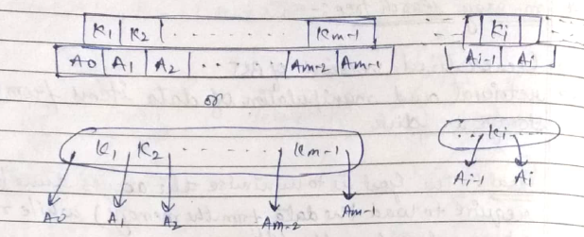
ii) If P is the order of the tree, then
2. If a node has k keys than, k<=m-1 than the keys are k1,k2,k3,….km such that ki<ki+1 also each of the keys in the node partition the sub trees into k+1 subsets.
3. For any node all the keys in the subtree pointed by Ai-1 are less than the key ki and all the keys in the sub tree pointed by Ai are greter than the key ki.
4. Each subtree pointed by ai are also m-way search tree.
 | Max | Min
Child pointers | P | ┌ P/2 ┐
Key | P-1 | ┌P/2 ┐-1

Slide 7
Insertion in the B-Tree
Search the element in the B-Tree is the same manner as in the m-way search tree.
If the element is not present then search tends to finish at some leaf node.
Two cases arise-
Case 1. When leaf element is not full then insert element into it.
Case 2. When leaf node is full
Insert the element into the node
Split the node at its median into two nodes at the same level and pushing the median element up by one level into the parent node.
If parent node accommodating the median element is not full then exit otherwise repeat the above steps. It may even call the rearrangement of keys in the root nodes or the formation of new root itself.

Slide 8


Constructing a B Tree
Example key :- P,A,Q,S,B,X,C,L,Z,Y,T,G,J,I,D,H,R,V,E,U,F,R. Order = 5
1. Insert P
2. Insert P

Slide 9


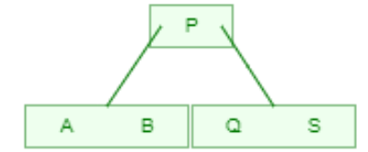
Constructing a B Tree
Example key :- P,A,Q,S,B,X,C,L,Z,Y,T,G,J,I,D,H,R,V,E,U,F,R,O.
1. Insert Q
2. Insert S
3. Insert B

Slide 10
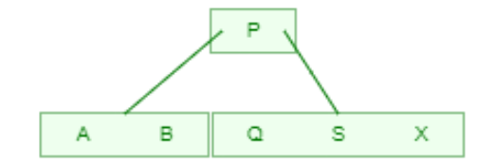
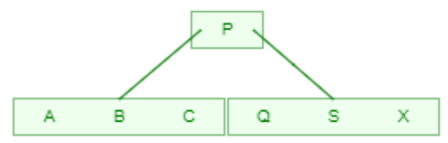

4. Insert X
5. Insert C
6. Insert L

Slide 11

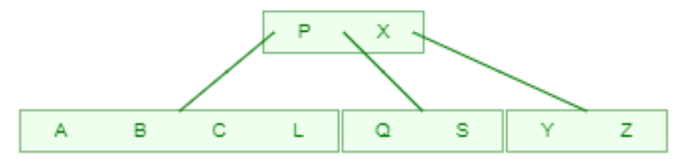
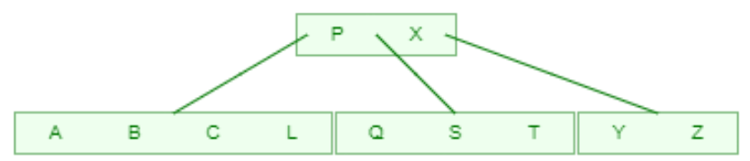
7. Insert Z
8. Insert Y
9. Insert T

Slide 12
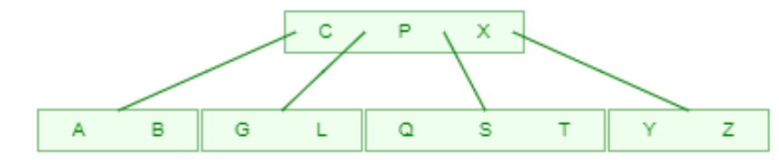
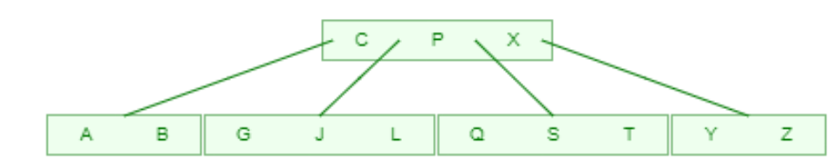
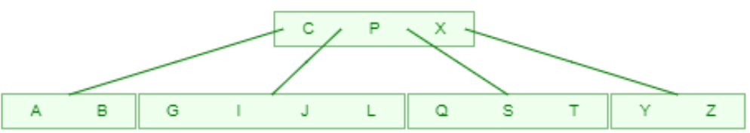
10. Insert G
11 Insert J
12 Insert I

Slide 13
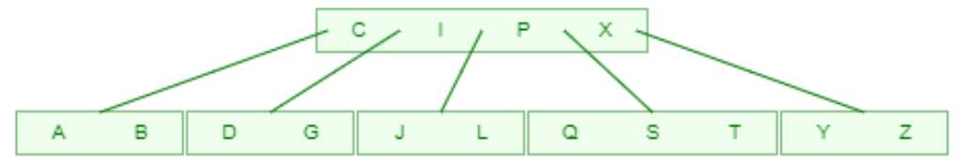
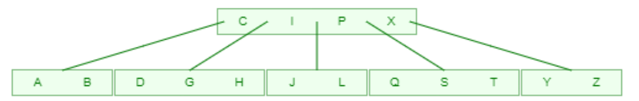
13. Insert D
14. Insert H

Slide 14
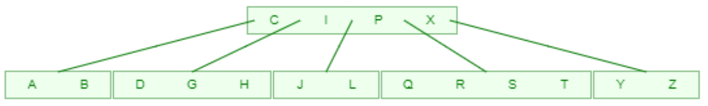
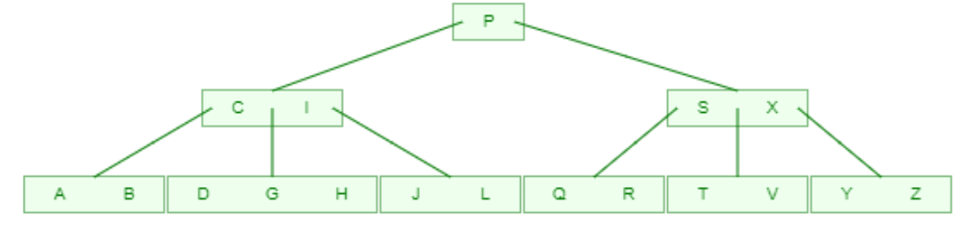
15. Insert R
16. Insert V

Slide 15
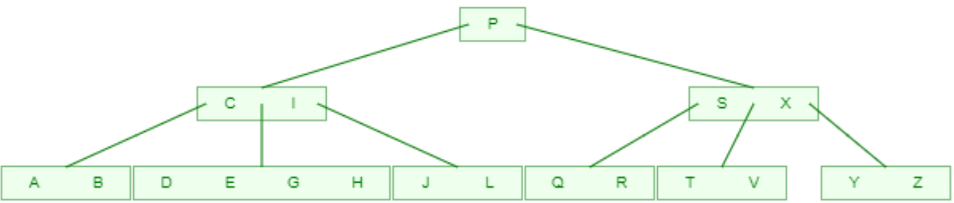
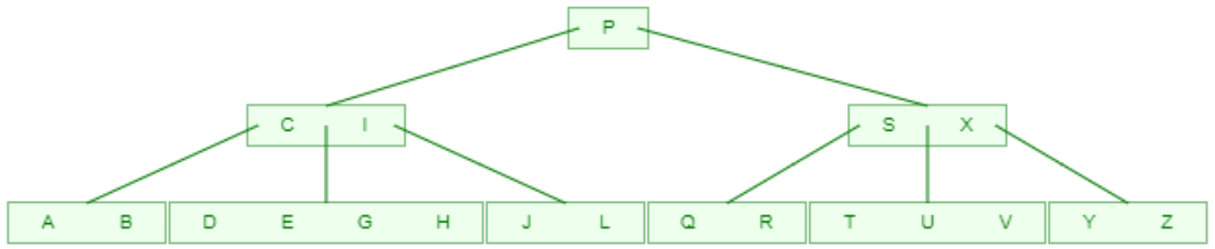
17. Insert E
18. Insert U

Slide 16
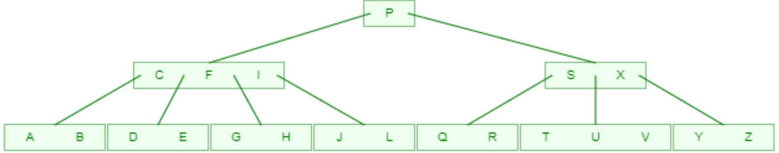
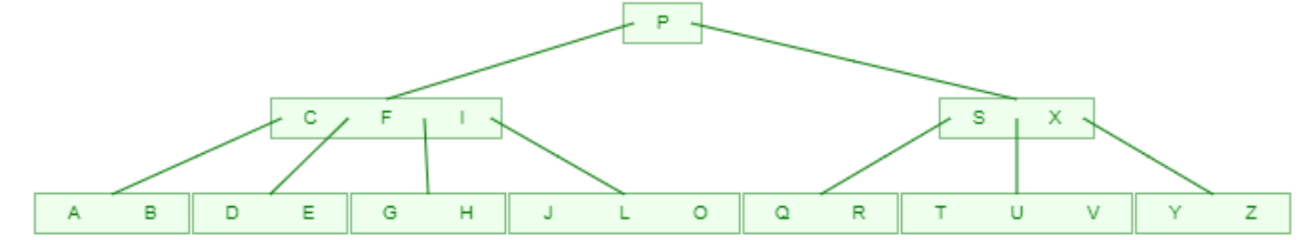
19. Insert F
20. Insert O

Slide 17

Constructing a B Tree
Example key :- 1,12,8,2,25,6,14,28,17,7,52,16,48,68,3,26,29,53,55,45,67. Order = 5 , then
Procedure for adding key in b-tree
Step1. Add first key as root node.
 | Max | Min
Child pointers | 5 | 3
Key | 4 | 2

Slide 18
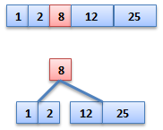
Step2. Add next key at the appropriate place in sorted order.
Step3. Same process applied until root node full. if root node full then splitting process applied.

Slide 19
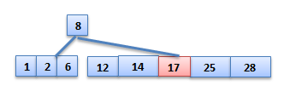
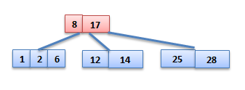
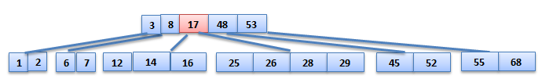

Slide 20
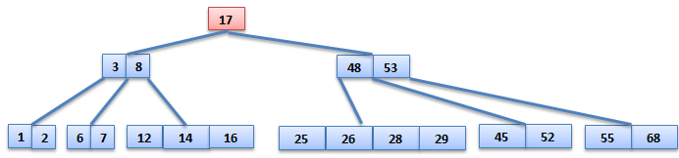

Slide 21



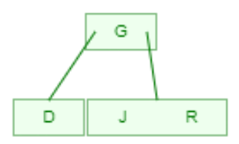
Example key :-J, R, D, G, T, E, M, H, P, A, F, Q Order = 4
 | Max | Min
Child pointers | 4 | 2
Key | 3 | 1

Slide 22
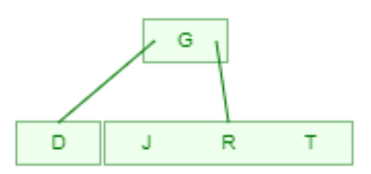
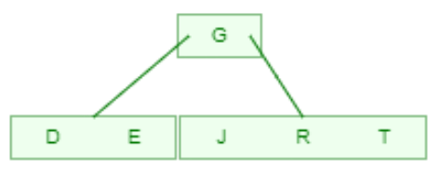
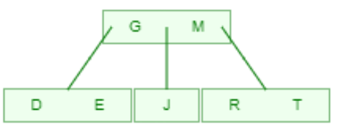
Example key :-J, R, D, G, T, E, M, H, P, A, F, Q Order = 4

Slide 23
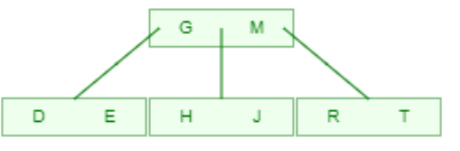
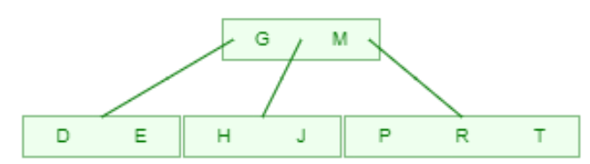
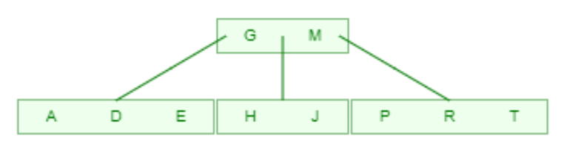
Example key :-J, R, D, G, T, E, M, H, P, A, F, Q Order = 4

Slide 24
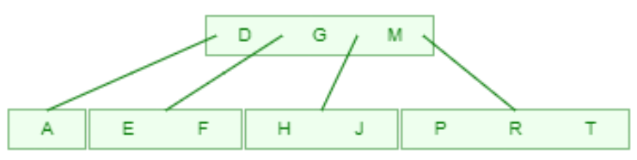
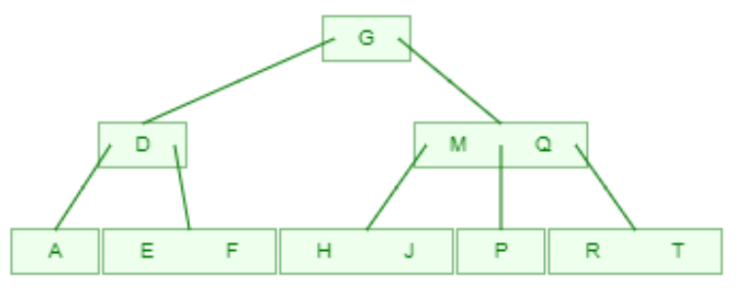
Example key :-J, R, D, G, T, E, M, H, P, A, F, Q Order = 4

Slide 25
Deletion in B-Tree
For deletion in B-Tree we wish to remove from a leaf. There are three possible case for deletion in b tree. Let k be the key to be deleted, x the node containing the key. Then the cases are:
Case-I
If the key is already in a leaf node, and removing it doesn’t cause that leaf node to have too few keys, then simply remove the key to be deleted. key k is in node x and x is a leaf, simply delete k from x.

Slide 26
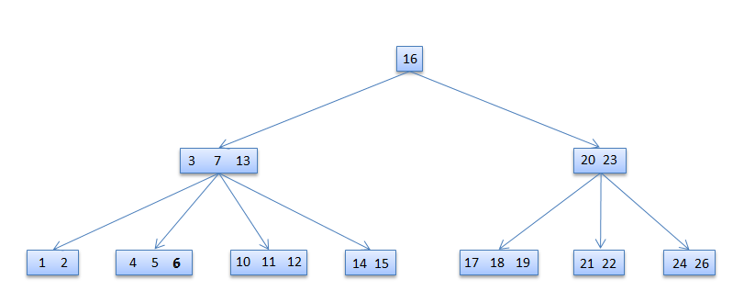
Delete 6

Slide 27
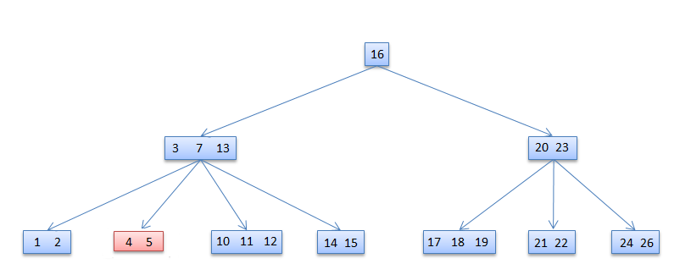
6 deleted

Slide 28
Case-II
If key k is in node x and x is an internal node, there are three cases to consider: Case-II-a
If the child y that precedes k in node x has at least t keys (more than the minimum), then find the predecessor key k' in the subtree rooted at y. Recursively delete k' and replace k with k' in x

Slide 29
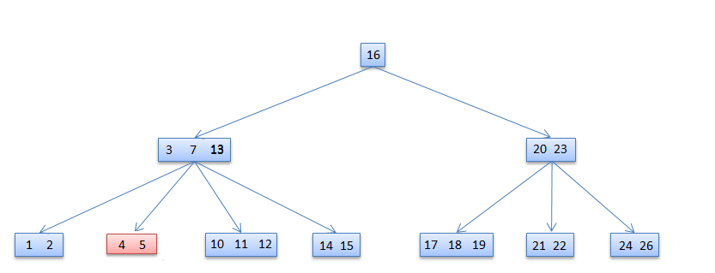
Case-II-b
Symmetrically, if the child z that follows k in node x has at least t keys, find the successor k' and delete and replace as before. Note that finding k' and deleting it can be performed in a single downward pass.

Slide 30
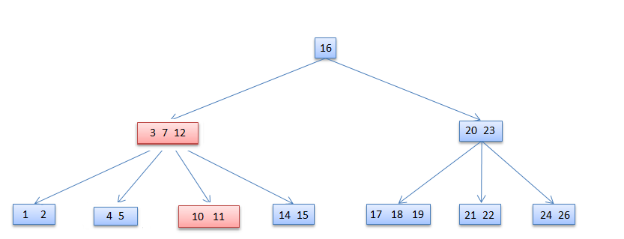
13 deleted

Slide 31

Case-II-c
Otherwise, if both y and z have only t−1 (minimum number) keys, merge k and all of z into y, so that both k and the pointer to z are removed from x. y now contains 2t − 1 keys, and subsequently k is deleted.

Slide 32
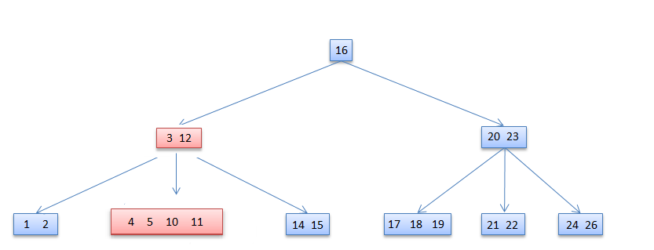
7 deleted

Slide 33
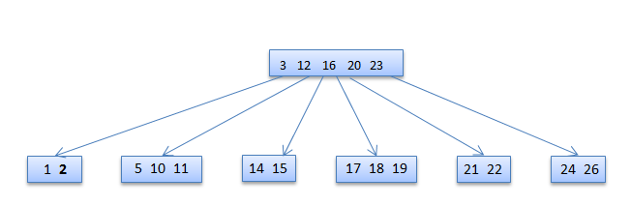
Case-III
If key k is not present in an internal node x, determine the root of the appropriate subtree that must contain k. If the root has only t − 1 keys, execute either of the following two cases to ensure that we descend to a node containing at least t keys. Finally, recurse to the appropriate child of x.
Case-III-a
If the root has only t−1 keys but has a sibling with t keys, give the root an extra key by moving a key from x to the root, moving a key from the roots immediate left or right sibling up into x, and moving the appropriate child from the sibling to x.
Case-III-b
If the root and all of its siblings have t−1 keys, merge the root with one sibling. This involves moving a key down from x into the new merged node to become the median key for that node.

Slide 34
Reasons for using B-Trees
When searching tables held on disc, the cost of each disc transfer is high but doesn't depend much on the amount of data transferred, especially if consecutive items are transferred
If we use a B-tree of order 101, say, we can transfer each node in one disc read operation
A B-tree of order 101 and height 3 can hold 101⁴ – 1 items (approximately 100 million) and any item can be accessed with 3 disc reads (assuming we hold the root in memory).

Slide 35


